Slide 1
Practice of RL (Value-based & Policy-based RL)
Kyowoon Lee*†
Sol-A Kim*
Jaesik Choi
Ulsan National Institute of Science and Technology (UNIST)

Slide 2
Tutorial codes
Slide & RL tutorial codes
https://github.com/leekwoon/AI-Robotics-Summer-School-RL

Slide 3
Contents
Recap of Reinforcement Learning (RL)
Value-based RL
SARSA
Q-learning
Deep Q-learning
Policy-based RL
Vanilla Policy Gradient
Actor-Critic
eXplainable AI (XAI)

Slide 4
Contents
Recap of Reinforcement Learning (RL)
Value-based RL
SARSA
Q-learning
Deep Q-learning
Policy-based RL
Vanilla Policy Gradient
Actor-Critic
eXplainable AI (XAI)

Slide 5


Recap of RL
Action
Agent
Environment
Reward
State
Goal : Train an Agent to take the optimal action

Slide 6
Recap of RL
Action
Agent
Environment
Reward
State
Goal : Train an Agent to take the optimal action

Slide 7




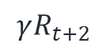
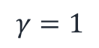
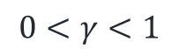
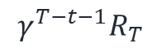
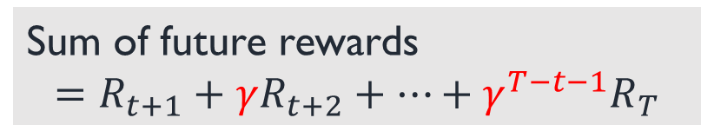
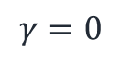
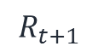


Value-based RL
State
(s)
Action
(a)
Discount Factor ($γ$)
$$γ=0$$
Q
$$0<γ<1$$
$$…$$
Value
$$γ=1$$
$$…$$
Sum of future rewards
$$=R_{t+1}+γR_{t+2}+…+γ^{T−t−1}R_{T}$$
$$R_{t+1}$$
$$γR_{t+2}$$
$$γ^{T−t−1}R_{T}$$

Slide 8
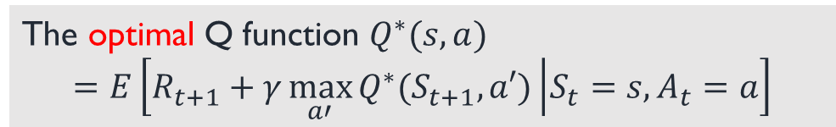
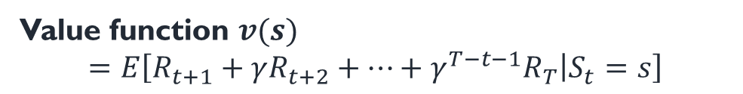

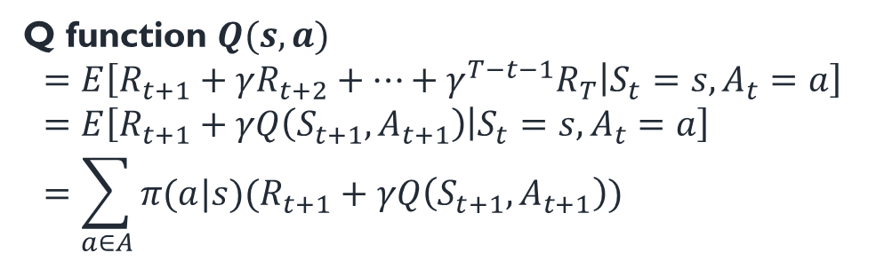
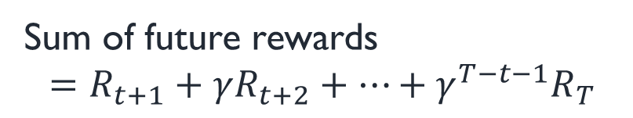
Value-based RL
Value function $v(s)$
$$=E\left[R_{t+1}+γR_{t+2}+…+γ^{T−t−1}R_{T} | S_{t}=s\right]$$
State
(s)
Action
(a)
Q function $Q(s,a)$
$$=E\left[R_{t+1}+γR_{t+2}+…+γ^{T−t−1}R_{T} | S_{t}=s,A_{t}=a\right] \\ =E\left[R_{t+1}+γQ\left(S_{t+1},A_{t+1}\right) | S_{t}=s,A_{t}=a\right] \\ =\sum_{a∈A}{π(a|s)(R_{t+1}+γQ\left(S_{t+1},A_{t+1}\right))}$$
Q
Policy
SARSA
Bellman expectation equation
The expected Q function $Q(s,a)$
$$=E\left[R_{t+1}+γQ(S_{t+1},a′) | S_{t}=s,A_{t}=a\right]$$
Value
Sum of future rewards
$$=R_{t+1}+γR_{t+2}+…+γ^{T−t−1}R_{T}$$
Bellman optimality equation
Q-learning
The optimal Q function $Q^{∗}(s,a)$
$$=E\left[R_{t+1}+γ\max_{a′}{Q^{∗}(S_{t+1},a′)} | S_{t}=s,A_{t}=a\right]$$

Slide 9
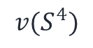

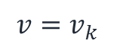
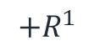
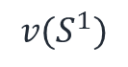

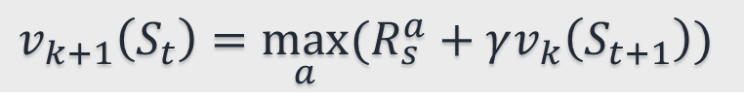
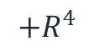
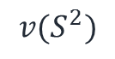


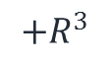

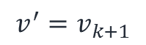
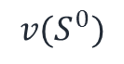
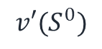
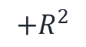
Value-based RL
Value Iteration
(k)-th iteration
(k+1)-th iteration
$$+R^{1}$$
$$v(S^{1})$$
$$v(S^{1})$$
$$+R^{2}$$
Max
$$v(S^{2})$$
$$v(S^{0})$$
$$v(S^{3})$$
$$v(S^{2})$$
$$v′(S^{0})$$
$$v(S^{3})$$
$$+R^{3}$$
$$v(S^{4})$$
$$v(S^{4})$$
$$+R^{4}$$
$$v_{k+1}\left(S_{t}\right)=\max_{a}{(R_{s}^{a}+γv_{k}\left(S_{t+1}\right))}$$
: Transition
$${v=v}_{k}$$
$${v^{′}=v}_{k+1}$$

Slide 10
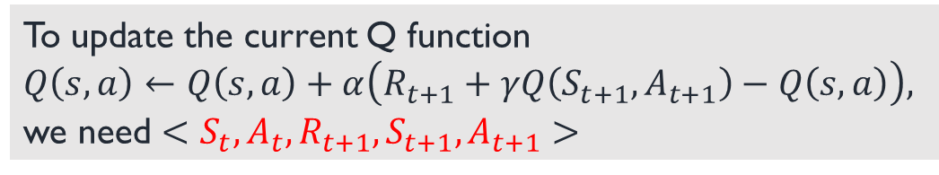
Value-based RL (SARSA)
Bellman expectation equation
$$Q(s,a)=E\left[R_{t+1}+γQ(S_{t+1},a′) | S_{t}=s,A_{t}=a\right]$$
Update Q function
$$Q\left(s,a\right)←\left(1−α\right)Q\left(s,a\right)+α(R_{t+1}+γQ(S_{t+1},A_{t+1}))$$
Learning rate (to update gradually)
To update the current Q function
$Q\left(s,a\right)←Q\left(s,a\right)+α\left(R_{t+1}+γQ\left(S_{t+1},A_{t+1}\right)−Q\left(s,a\right)\right),$ we need $<S_{t},A_{t},R_{t+1},S_{t+1},A_{t+1}>$
Error term (Target - Prediction)

Slide 11
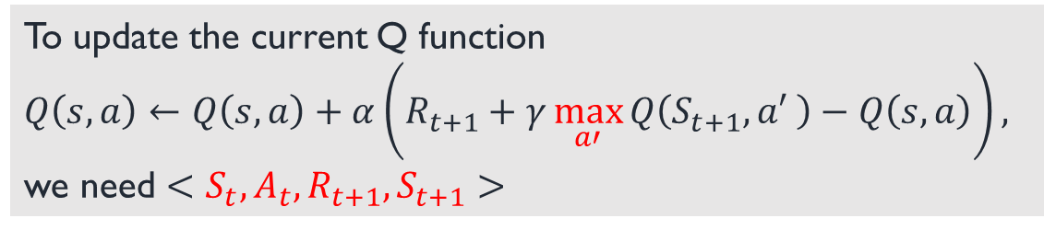
Value-based RL (Q-learning)
Bellman optimality equation
$$Q\left(s,a\right)=E\left[R_{t+1}+γ\max_{a′}{Q(S_{t+1},a′)} | S_{t}=s,A_{t}=a\right]$$
Update Q function
$$Q\left(s,a\right)←\left(1−α\right)Q\left(s,a\right)+α(R_{t+1}+γ\max_{a′}{Q(S_{t+1},A_{t+1})})$$
To update the current Q function
$Q\left(s,a\right)←Q\left(s,a\right)+α\left(R_{t+1}+γ\max_{a′}{Q\left(S_{t+1},a′ \right)}−Q\left(s,a\right)\right),$ we need $<S_{t},A_{t},R_{t+1},S_{t+1}>$

Slide 12
Value-based RL (Deep Q-learning)
Approximate q function to artificial neural networks
Input
(State vector)
Hidden layers
Output
(Q-values per action)

Slide 13

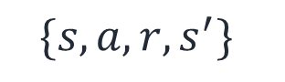
Value-based RL (Deep Q-learning cont.)
Experience Replay
Explore
$$\{s,a,r,s^{′}\}$$
Save
Agent
Memory buffer
Draw
random memories
Learn
Train data

Slide 14
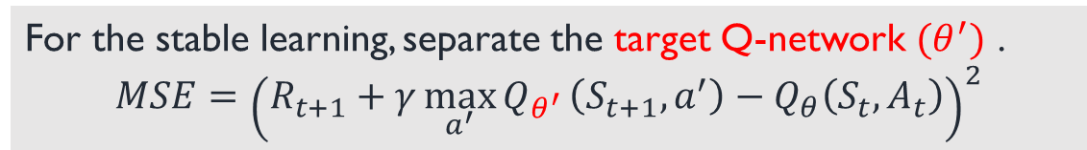
Value-based RL (Deep Q-learning cont.)
Target Q-network
For the stable learning, separate the target Q-network ${(θ}^{′})$ .
$$MSE={\left(R_{t+1}+γ{\max_{a^{′}}{Q}}_{θ^{′}}\left(S_{t+1},a^{′}\right)−Q_{θ}\left(S_{t},A_{t}\right)\right)}^{2}$$
Update the target Q-network ${(θ}^{′})$ periodically or slowly.

Slide 15
GridWorld
Q-learning
SARSA

Slide 16
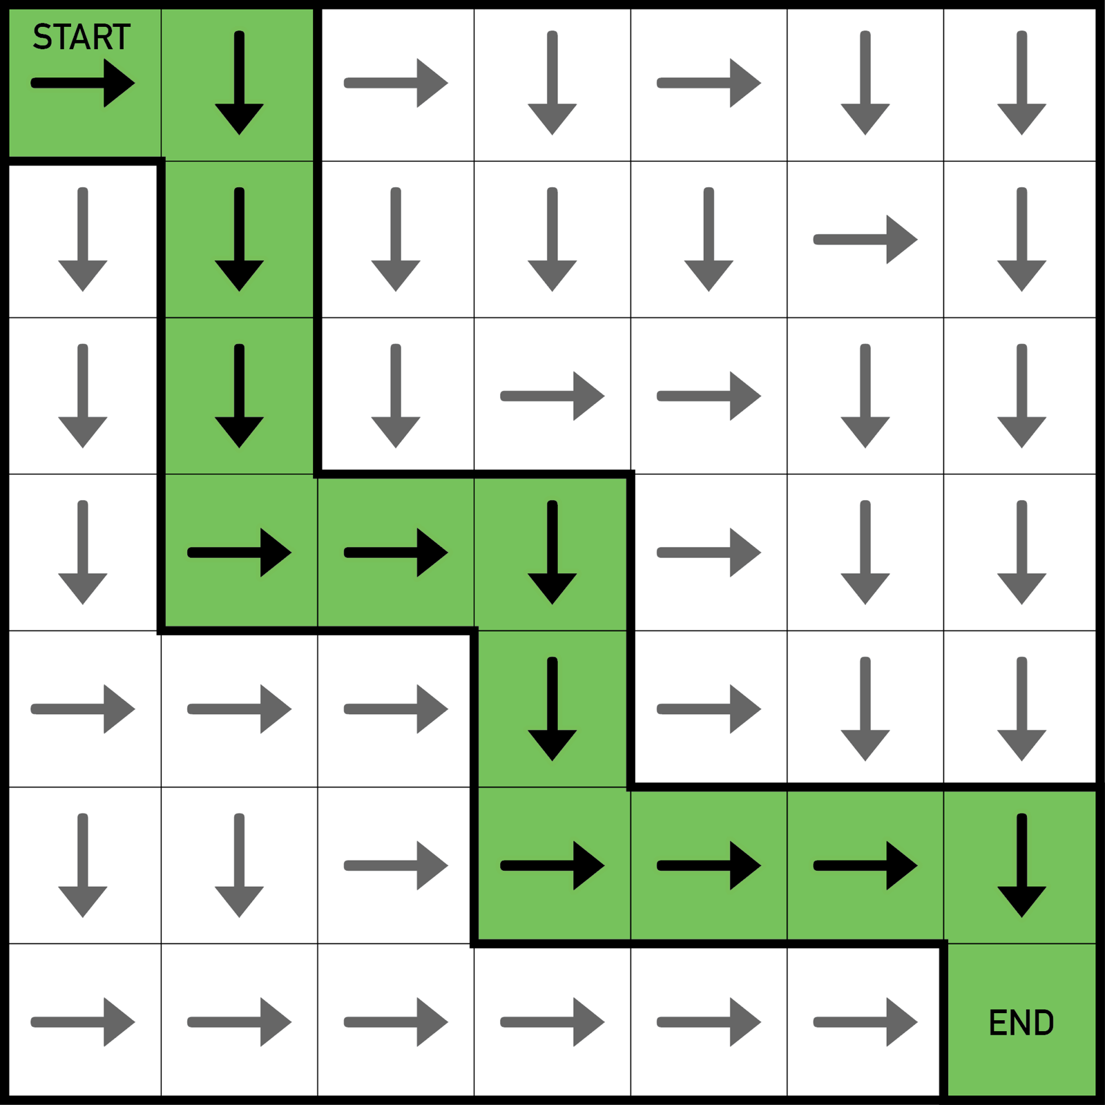
Environment
Simple example
GridWorld
Goal:
Train an agent to find an optimized path

Slide 17
Environment
MDP of GridWorld
▶States:
Coordinates of the grid
▶Actions:
{up, right, down, left}
▶Reward:
{Destination (+1), Others (-1), Obstacles (-10)}
▶State-transition probability:
Assume deterministic transition

Slide 18
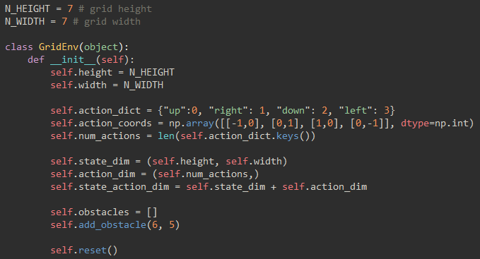
Environment (Implementation)
Initialize
Width (7)
(0, 0)
Create environment with predefined height and width
Height (7)
(6, 6)

Slide 19
Environment (Implementation)
Initialize
Define set of actions
Agent

Slide 20


Environment (Implementation)
Initialize
Add obstacles &
Reset position of the agent
(6, 6)

Slide 21
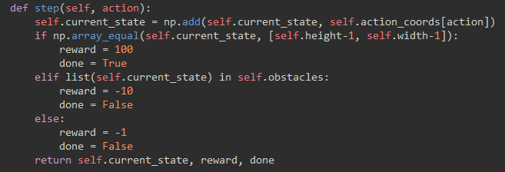
Environment (Implementation)
Step
Execute action & Returns (state, reward, done)
Whether the episode finished

Slide 22
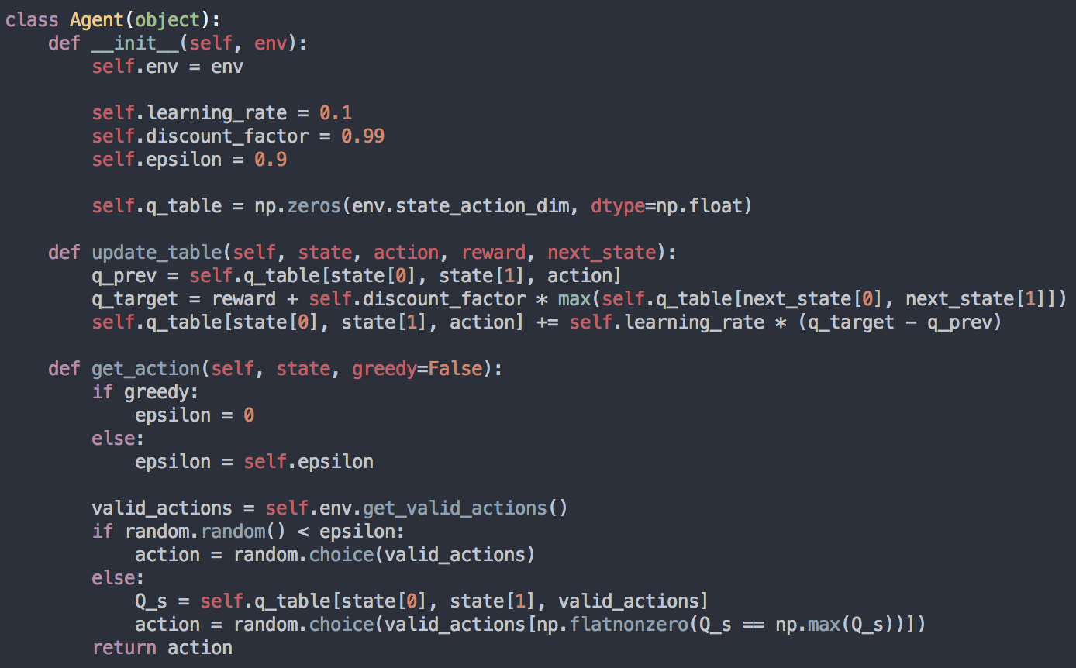
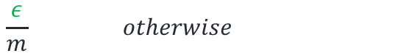
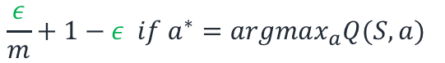
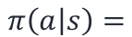
Q-learning Agent (Implementation)
Initialize
$$\frac{ε}{m}+1−ε if a^{∗}=argmax_{a}Q(S,a)$$
$$π\left(a | s\right)=$$
$$\frac{ε}{m} otherwise$$
Epsilon
$$Q\left(S_{t}, { A}_{t}\right)←Q\left(S_{t}, { A}_{t}\right)+α\left[R_{t+1}+γ\max_{a} Q\left(S_{t+1}, a\right)−Q(S_{t}, A_{t})\right]$$
Construct Q table
Learning rate
Discount factor

Slide 23
Q-learning Agent (Implementation)
Update Table
Update Q table from the sample $<S_{t}, A_{t}, R_{t+1},S_{t+1}>$
$$Q\left(S_{t}, { A}_{t}\right)←Q\left(S_{t}, { A}_{t}\right)+α\left[R_{t+1}+γ\max_{a} Q\left(S_{t+1}, a\right)−Q(S_{t}, A_{t})\right]$$
Learning rate
Discount factor

Slide 24
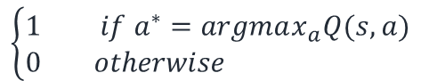
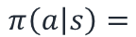
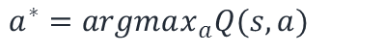
Q-learning Agent (Implementation)
Get Action
greedy policy
$$\left\{\begin{aligned}1 if a^{∗}=argmax_{a}Q(s,a) \\ 0 otherwise \end{aligned}\right.$$
$$π\left(a | s\right)=$$
$$a^{∗}=argmax_{a}Q(s,a)$$

Slide 25
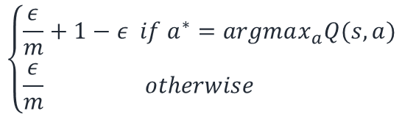
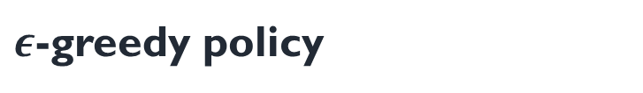

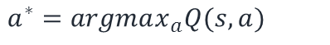
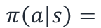
Q-learning Agent (Implementation)
Get Action
$ε$-greedy policy
$$\left\{\begin{aligned}\frac{ε}{m}+1−ε if a^{∗}=argmax_{a}Q(s,a) \\ \frac{ε}{m} otherwise \end{aligned}\right.$$
$$π\left(a | s\right)=$$
$$ε$$
$$a^{∗}=argmax_{a}Q(s,a)$$

Slide 26
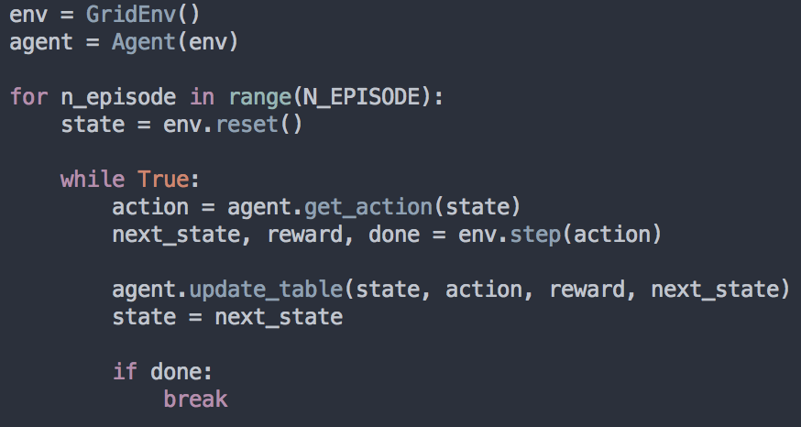
Q-learning Train (Implementation)
Agent
Environment
Goal

Slide 27
Q-learning Train (Implementation)
Agent
Environment
Goal

Slide 28
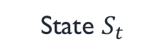
Q-learning Train (Implementation)
Agent
State $S_{t}$
Environment
Goal

Slide 29
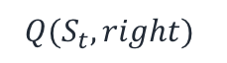
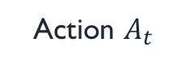
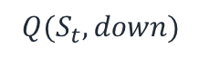
Q-learning Train (Implementation)
Agent
State $S_{t}$
Action $A_{t}$
Environment
Use e-greedy policy
$${Q(S}_{t}, right)$$
$${Q(S}_{t}, down)$$
Goal

Slide 30
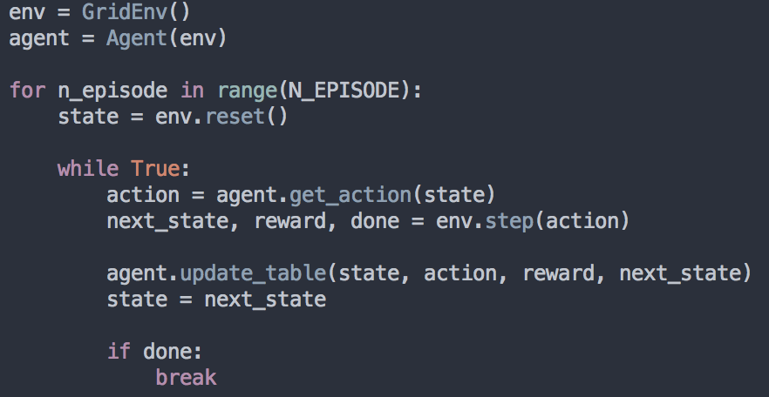
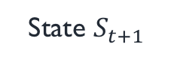
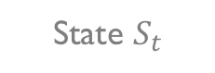
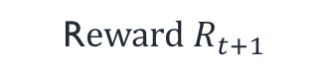
Q-learning Train (Implementation)
Agent
State $S_{t}$
R$eward R_{t+1}$
Action $A_{t}$
State $S_{t+1}$
Environment
Goal

Slide 31
Q-learning Train (Implementation)
Agent
State $S_{t}$
R$eward R_{t+1}$
Action $A_{t}$
State $S_{t+1}$
Environment
Update Q table from the sample $<S_{t}, A_{t}, R_{t+1},S_{t+1}>$
Goal

Slide 32

Q-learning Train (Implementation)

Slide 33

Q-learning Play (Implementation)

Slide 34

SARSA (Implementation)
SARSA
Q-learning
$$Q\left(S_{t}, { A}_{t}\right)←Q\left(S_{t}, { A}_{t}\right)+α\left[R_{t+1}+γ Q\left(S_{t+1}, A_{t+1}\right)−Q(S_{t}, A_{t})\right]$$
$$Q\left(S_{t}, { A}_{t}\right)←Q\left(S_{t}, { A}_{t}\right)+α\left[R_{t+1}+γ\max_{a} Q\left(S_{t+1}, a\right)−Q(S_{t}, A_{t})\right]$$
Update Q table from the sample $<S_{t}, A_{t}, R_{t+1},S_{t+1}, A_{t+1}>$
Update Q table from the sample $<S_{t}, A_{t}, R_{t+1},S_{t+1}>$
SARSA

Slide 35
Cart-pole
Deep Q-learning

Slide 36
Requirement
Pip install gym

Slide 37



Environment
Cartpole
▶Goal: prevent it from falling over
▶Actions: applying a force to left/right
▶State: {$x, \dot{x}, θ,\dot{θ}$}
▶Reward: +1 for every time step
▶ Termination: $θ$ or $x$ is out of range

Slide 38

DQN Network (Implementation)
Initialize

Slide 39

DQN Network (Implementation)
Initialize
Build/Define network architecture

Slide 40
DQN Network (Implementation)
Initialize
Define objective function
and train_op

Slide 41



DQN Network (Implementation)
Create Network
Q network

Slide 42


DQN Network (Implementation)
Create Network
Q network
$$Q(S, left)$$
$$Q(S, right)$$

Slide 43

DQN Network (Implementation)
Create Network
Q network
Target Q network
$$Q(S, left)$$
$$Q(S, right)$$

Slide 44


DQN Network (Implementation)
Create Network
Q network
Target Q network
Copy/Paste parameters

Slide 45

DQN Network (Implementation)
Create Train Op
$$Cost= {\left(r+ γ\max_{a^{′}} \hat{Q}\left(s^{′},a^{′}\right)−Q\left(s,a\right)\right)}^{2}$$
With Q network

Slide 46

DQN Network (Implementation)
Create Train Op
$$Cost= {\left(r+ γ\max_{a^{′}} \hat{Q}\left(s^{′},a^{′}\right)−Q\left(s,a\right)\right)}^{2}$$
With target Q network
With Q network

Slide 47
DQN Network (Implementation)
Create Train Op
$$Cost= {\left(r+ γ\max_{a^{′}} \hat{Q}\left(s^{′},a^{′}\right)−Q\left(s,a\right)\right)}^{2}$$
With target Q network
With Q network

Slide 48


DQN Train (Implementation)
Environment

Slide 49
DQN Train (Implementation)
Agent
Environment

Slide 50

DQN Train (Implementation)
Agent
Environment

Slide 51

DQN Train (Implementation)
Agent
State $S_{t}$
Environment

Slide 52

DQN Train (Implementation)
Agent
State $S_{t}$
Action $A_{t}$
Environment
Which action ? ➔ e-greedy policy

Slide 53

DQN Train (Implementation)
Agent
State $S_{t}$
R$eward R_{t+1}$
Action $A_{t}$
State $S_{t+1}$
Environment
Which action ? ➔ e-greedy policy

Slide 54

DQN Train (Implementation)
Agent
State $S_{t}$
R$eward R_{t+1}$
Action $A_{t}$
State $S_{t+1}$
Environment
Add $<S_{t}, A_{t}, R_{t+1},S_{t+1}>$ to replay memory

Slide 55
DQN Train (Implementation)
Agent
State $S_{t}$
R$eward R_{t+1}$
Action $A_{t}$
State $S_{t+1}$
Environment
Train network using batch from replay memory

Slide 56
DQN Train (Implementation)
Agent
State $S_{t}$
R$eward R_{t+1}$
Action $A_{t}$
State $S_{t+1}$
Environment
Update target q network

Slide 57

DQN Train (Implementation)

Slide 58
Practice of RL (Value-based & Policy-based RL)
Kyowoon Lee*†
Sol-A Kim*
Jaesik Choi
Ulsan National Institute of Science and Technology (UNIST)

Slide 59
Contents
Recap of Reinforcement Learning (RL)
Value-based RL
SARSA
Q-learning
Deep Q-learning
Policy-based RL
Vanilla Policy Gradient
Actor-Critic
eXplainable AI (XAI)

Slide 60
Policy-based RL (with Deep Learning)
Directly parameterize the policy
Input
(State vector)
Hidden layers
Output
(Policy: probabilities per action)
Value-based
(Q-values per action)

Slide 61





Policy-based RL (with Deep Learning cont.)
Policy
Policy network
(Parameterized by $θ$)
$$π_{θ}\left(a | s\right)=P[A_{t}=a|S_{t}=s,θ]$$
Optimal Policy
The policy maximize the sum of rewards
$$J(θ)=E\left[R_{1}+R_{2}+…+R_{T} | π_{θ}\right] \\ =E \left[\sum_{t=1}^{T}{R_{t}} | π_{θ}\right]$$
Update $θ$ maximizing $J(θ)$
Using gradient ascent method,
$$θ←θ+∇_{θ}J\left(θ\right)$$
Input
(State vector)
Hidden layers
Output
(Policy)

Slide 62




Policy-based RL (Vanilla Policy Gradient)
Run the policy$π_{θ}$
Fit a model to the estimate return
$$∇_{θ}J(θ)≈∇_{θ}logπ_{θ}(A_{t}|S_{t})(\sum_{t=0}^{T}{R(S_{t},A_{t}))}$$
Trajectory=$\{S_{0},A_{0},R_{1},S_{1},A_{1},…,S_{T}\}$
Policy gradient
Sum of rewards
Improve the policy
$$θ←θ+{α∇}_{θ}J\left(θ\right)$$
Sum of rewards guides which direction to update.
It encourage to train the agent
not to follow a bad path but to follow a good path.
Step size

Slide 63



Policy-based RL (Vanilla Policy Gradient)
High variance problem
$$θ←θ+{α∇}_{θ}J\left(θ\right)$$
Gradient of the objective function
$$∇_{θ}J(θ)≈∇_{θ}logπ_{θ}(A_{t}|S_{t})(\sum_{t=0}^{T}{R(S_{t},A_{t}))}$$
Cause high variance
Advantage (Sum of rewards - Baseline)
To reduce the variance, subtract a baseline (value function) :
$$\sum_{t=1}^{T}{R\left(S_{t},A_{t}\right)−V(S_{t})}$$

Slide 64



Actor-Critic
Train both policy and value function separately
$$∇_{θ}J(θ)≈∇_{θ}logπ_{θ}(A_{t}|S_{t})(Q\left(S_{t},A_{t}\right)−V(S_{t}))$$
Policy gradient
Advantage
$$Q\left(S_{t},A_{t}\right)=R_{t+1}+γV(S_{t+1})$$
Update per episode
Update per timestep
Trajectory=$\{S_{0},A_{0},R_{1},S_{1},A_{1},…,S_{T}\}$
$$\{S_{t},A_{t},R_{t+1},S_{t+1},A_{t+1}\}$$
High variance
Low variance

Slide 65



Actor-Critic
Actor
Agent
Update the policy $π_{θ}$ suggested by critic
$$Loss=∇_{θ}logπ_{θ}(A_{t}|S_{t})(R_{t+1}+γV_{w}\left(S_{t+1}\right)−V_{w}\left(S_{t}\right))$$
Actor
x
Action
Critic
Update the value function $V_{w}$
State
$${Loss=\left(R_{t+1}+γV_{w}\left(S_{t+1}\right)−V_{w}\left(S_{t}\right)\right)}^{2}$$
Reward
Critic
If Actor updates the policy,
Critic evaluate its direction based on Advantage

Slide 66
Cart-pole
Deep Q-learning
Policy gradient
Actor-Critic

Slide 67
Vanilla PG Network (Implementation)
Initialize

Slide 68
Vanilla PG Network (Implementation)
Initialize
Build/Define network architecture
Define objective function
and train_op

Slide 69

Vanilla PG Network (Implementation)
Create Network
Policy network

Slide 70
Vanilla PG Network (Implementation)
Create Network
Policy network
Left
30%
Right
70%

Slide 71


Vanilla PG Network (Implementation)
Create Train Op
$$∇_{θ}J(θ)≈∇_{θ}logπ_{θ}(A_{t}|S_{t})\left(\sum_{i=t}^{T}{R(S_{i},A_{i})}\right)$$

Slide 72

Vanilla PG Network (Implementation)
Create Train Op
Sum of rewards
$$∇_{θ}J(θ)≈∇_{θ}logπ_{θ}(A_{t}|S_{t})\left(\sum_{i=t}^{T}{R(S_{i},A_{i})}\right)$$

Slide 73


Vanilla PG Network (Implementation)
Create Train Op
$$∇_{θ}J(θ)≈∇_{θ}logπ_{θ}(A_{t}|S_{t})\left(\sum_{t=i}^{T}{R(S_{i},A_{i})}\right)$$
$$θ←θ+{α∇}_{θ}J\left(θ\right)$$

Slide 74
Vanilla PG Train (Implementation)
Environment

Slide 75
Vanilla PG Train (Implementation)
Agent
Environment

Slide 76
Vanilla PG Train (Implementation)
Agent
State $S_{t}$
Environment

Slide 77

Vanilla PG Train (Implementation)
Agent
State $S_{t}$
Action $A_{t}$
Environment
Which action ? ➔ based on policy
Left
Right
70%
30%

Slide 78
Vanilla PG Train (Implementation)
Agent
State $S_{t}$
R$eward R_{t+1}$
Action $A_{t}$
State $S_{t+1}$
Environment
Which action ? ➔ based on policy
Left
Right
70%
30%

Slide 79

Vanilla PG Train (Implementation)
Agent
State $S_{t}$
R$eward R_{t+1}$
Action $A_{t}$
State $S_{t+1}$
Environment
Collect $<S_{t}, A_{t}, R_{t+1}>$ until the end of episode

Slide 80

Vanilla PG Train (Implementation)
Agent
State $S_{t}$
R$eward R_{t+1}$
Action $A_{t}$
State $S_{t+1}$
Environment
Accumulate rewards per each state
$<S_{t}, A_{t}, R_{t+1}>➔$ $<S_{t}, A_{t}, R_{t+1}+R_{t+2}+R_{t+3}+…+R_{T} >$

Slide 81
Vanilla PG Train (Implementation)
Agent
State $S_{t}$
R$eward R_{t+1}$
Action $A_{t}$
State $S_{t+1}$
Environment
Train network after end of each episode

Slide 82

Actor-Critic Network (Implementation)
Create Network
Policy network ( Actor)
Left
30%
Right
70%

Slide 83

Actor-Critic Network (Implementation)
Create Network
Policy network (Actor)
Value network (Critic)
Sum
of
future reward
$V(S_{t}$)

Slide 84

Actor-Critic Network (Implementation)
Create Train Op
Actor
$$Loss=∇_{θ}logπ_{θ}(A_{t}|S_{t})\left(\sum_{i=t}^{T}{R\left(S_{i},A_{i}\right)−V(S_{i})}\right)$$

Slide 85

Actor-Critic Network (Implementation)
Create Train Op
Actor
$$Loss=∇_{θ}logπ_{θ}(A_{t}|S_{t})\left(\sum_{i=t}^{T}{R\left(S_{i},A_{i}\right)−V(S_{i})}\right)$$
Critic
$${Loss=\left(R_{t+1}+γV\left(S_{t+1}\right)−V(S_{t}\right)}^{2}$$

Slide 86

Actor-Critic
Vanilla PG

Slide 87

eXplainable AI (XAI)
Visualize Actor-Critic model
Saliency Map
Agent
Critic
Actor
x
Action
State
Actor
Reward
Critic
Enable human to understand the model intuitively.
A. Fern’s Group, 2017

Slide 88

eXplainable AI (XAI)
Visualize Actor-Critic model
A. Fern’s Group, 2017

Slide 89
Atari
eXplainable AI (XAI)

Slide 90
eXplainable AI (XAI) (Requirements)
Download the code
Git clone https://github.com/OpenXAIProject/Visual-Explanation-of-Atari.git

Slide 91
eXplainable AI (XAI) (Requirements)
Install gym[atari]
Pip install gym[Atari]
Windows
Pip install git+https://github.com/Kojoley/atari-py.git
macOS
Brew install cmake
Pip install gym[Atari]

Slide 92

eXplainable AI (XAI) (Implementation)

Slide 93

eXplainable AI (XAI) (Implementation)

Slide 94


eXplainable AI (XAI) (Implementation)
Generate mask which gives high weight to the selected circle

Slide 95


eXplainable AI (XAI) (Implementation)
Generate blurred image by using gaussian filter

Slide 96


eXplainable AI (XAI) (Implementation)

Slide 97
eXplainable AI (XAI) (Implementation)

Slide 98
eXplainable AI (XAI) (Implementation)
Then, which part of image is important ?

Slide 99
eXplainable AI (XAI) (Implementation)
Let’s find using policy and value network
trained by actor critic

Slide 100
eXplainable AI (XAI) (Implementation)
First, get the policy from original state(image)

Slide 101
eXplainable AI (XAI) (Implementation)
And then, get the policy from perturbed state(image)

Slide 102



eXplainable AI (XAI) (Implementation)
Give high score if two policy is not similar
v.s.
w/o perturbation
w/ perturbation

Slide 103


eXplainable AI (XAI) (Implementation)
Breakout
Using actor
Using critic

Slide 104


eXplainable AI (XAI) (Implementation)
Pong
Using actor
Using critic

